Slide 1
BIOMEDIN 215: Data Science in Medicine
Large Language Models in Healthcare: A Technical Deep Dive

Slide 2
Outline
Outline
Applications of LLMs in the Real World
Inner Workings and Building Blocks of LLMs
What is an LLM?
Building an LLM from scratch
Foundation Models
What is a Foundation Model?
EHR Foundation Models
Challenges and Opportunities in Healthcare AI

Slide 3
Outline
Outline
Applications of LLMs in the Real World
Inner Workings and Building Blocks of LLMs
What is an LLM?
Building an LLM from scratch
Foundation Models
What is a Foundation Model?
EHR Foundation Models
Challenges and Opportunities in Healthcare AI

Slide 4
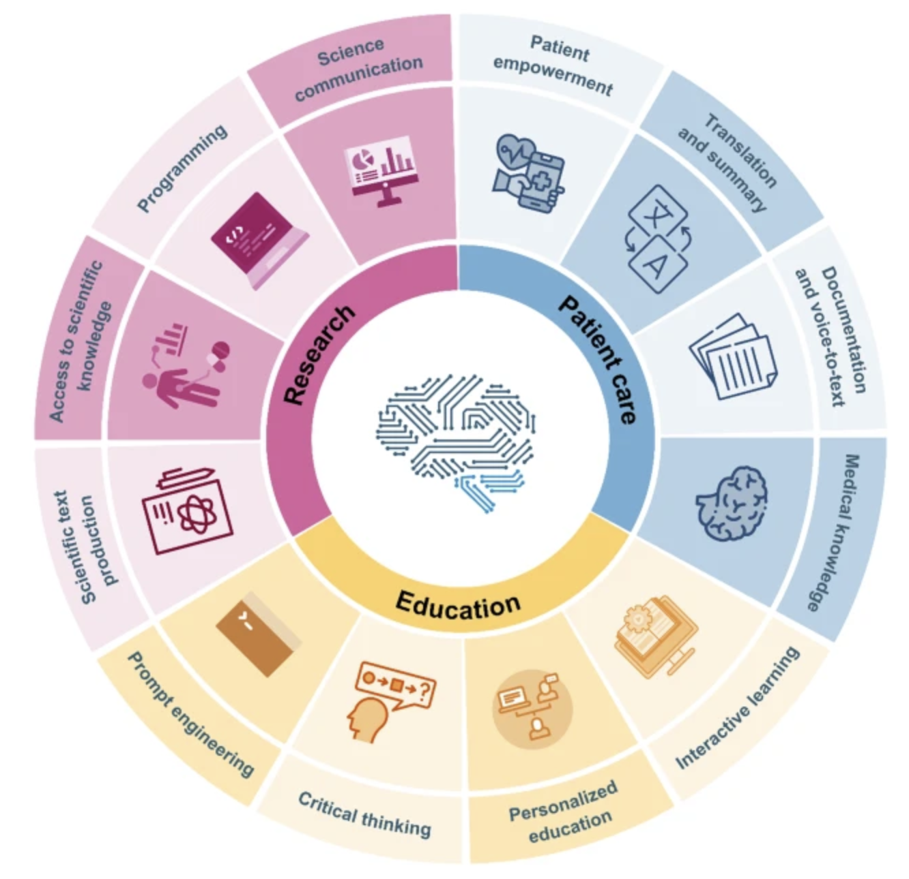
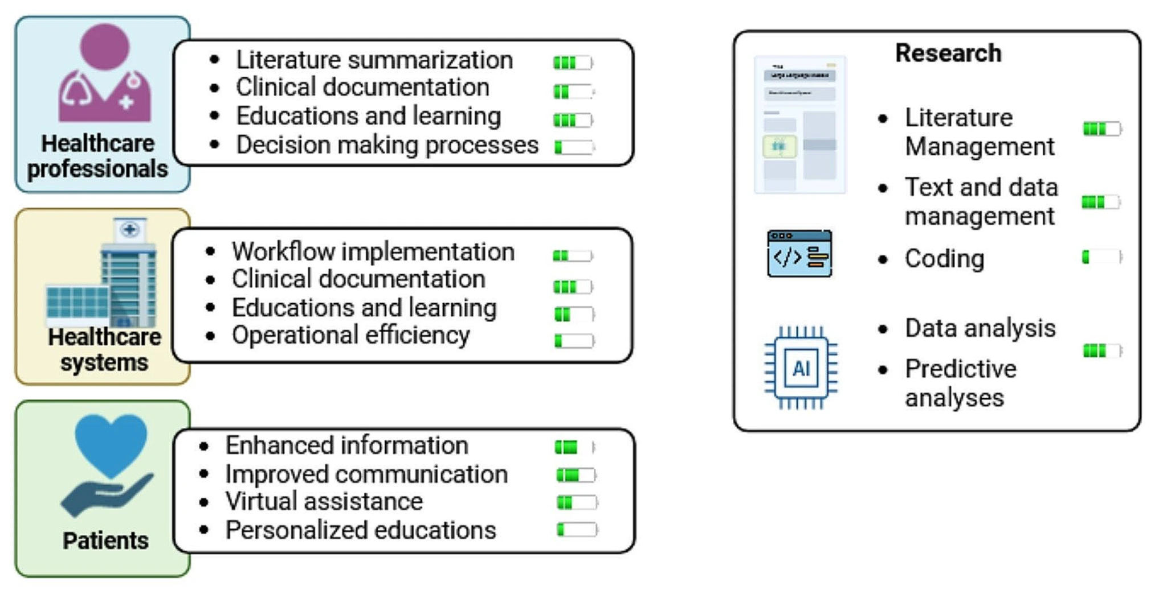
The promise of LLMs in Healthcare
How can LLMs transform healthcare?
Section 1
Potential of LLMs¹
6 months later²
1 https://www.nature.com/articles/s43856-023-00370-1?fromPaywallRec=false
2. https://link.springer.com/article/10.1007/s10916-024-02045-3

Slide 5
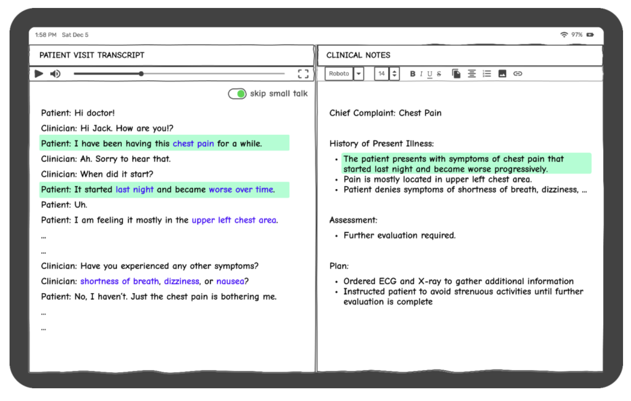
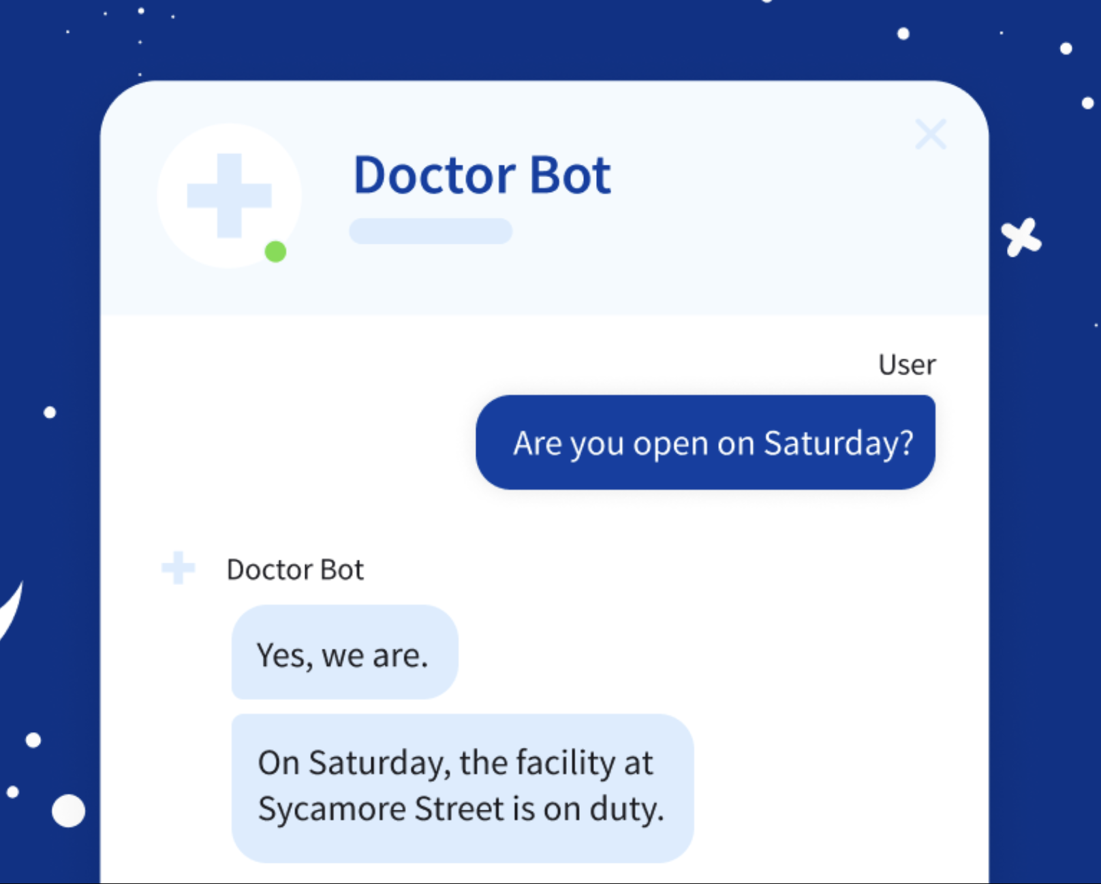

LLMs in Use
How are LLMs transforming healthcare?
Section 1
Ambient listening
Patient Chatbot
Virtual patient simulations
https://research.aimultiple.com/large-language-models-in-healthcare/#easy-footnote-bottom-11-7283411

Slide 6
Outline
Outline
Applications of LLMs in the Real World
Inner Workings and Building Blocks of LLMs
What is an LLM?
Building an LLM from scratch
Foundation Models
What is a Foundation Model?
EHR Foundation Models
Challenges and Opportunities in Healthcare AI

Slide 7
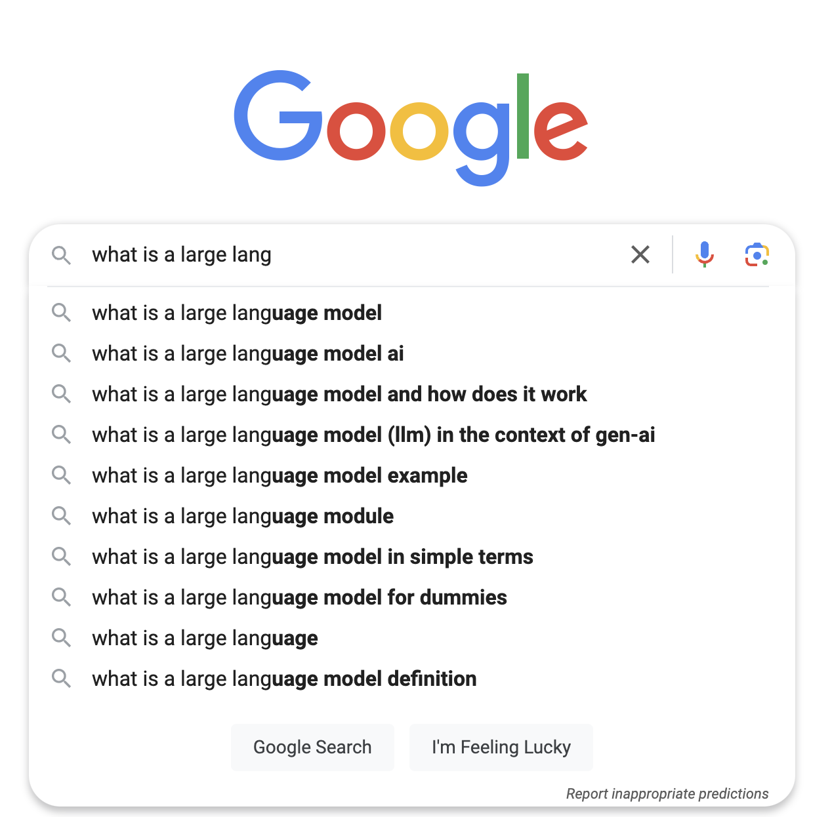
What is a language model?
Section 2
A language model is a probabilistic model that assigns a probability distribution to sequences of words in a language.
P(x_{n}|x₁, x₂, x₃, x₄, …., x_{(n-1)})

Slide 8
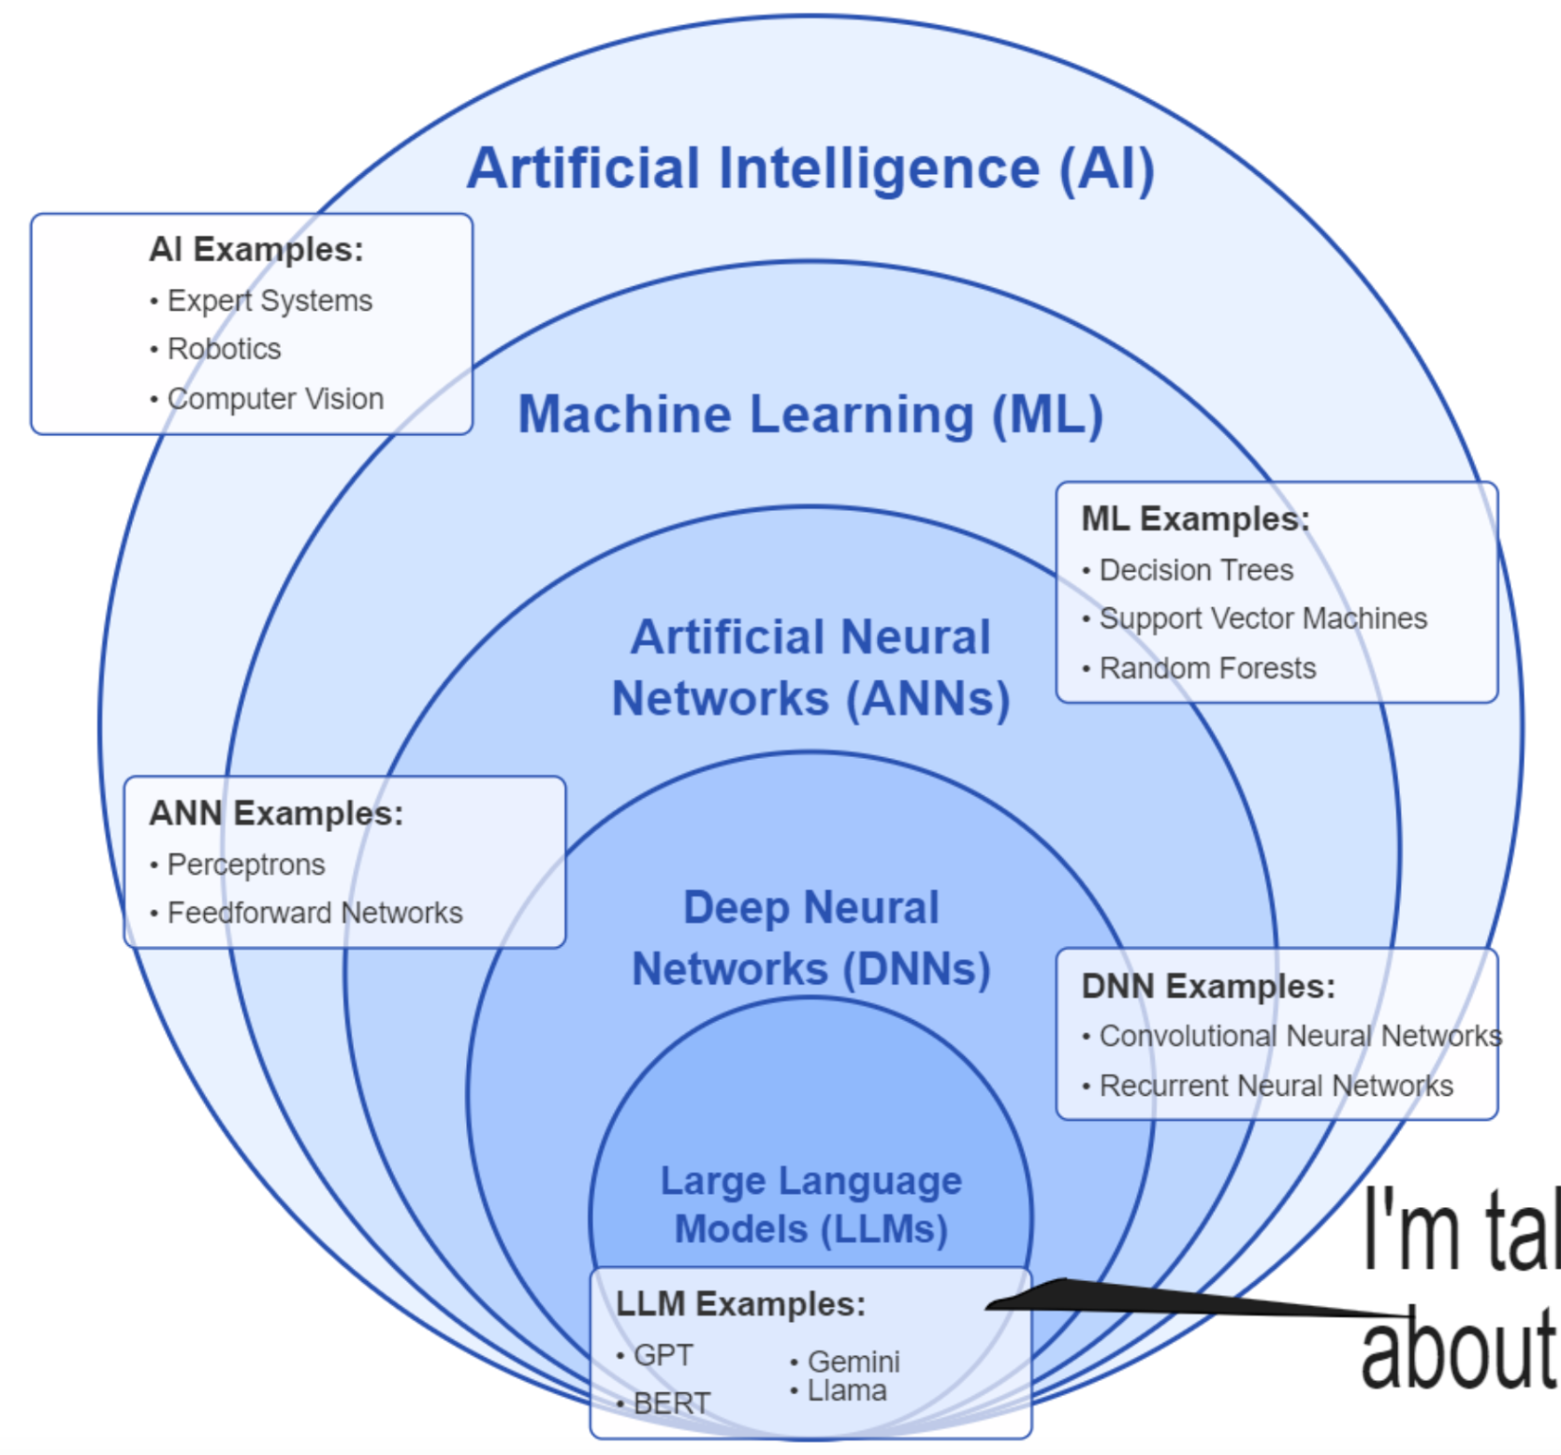

What is a large language model?
Section 2
A large language model is a type of language model that is large in terms of:
Training Data
Model Size
It’s a just a subfield!
Our focus

Slide 9
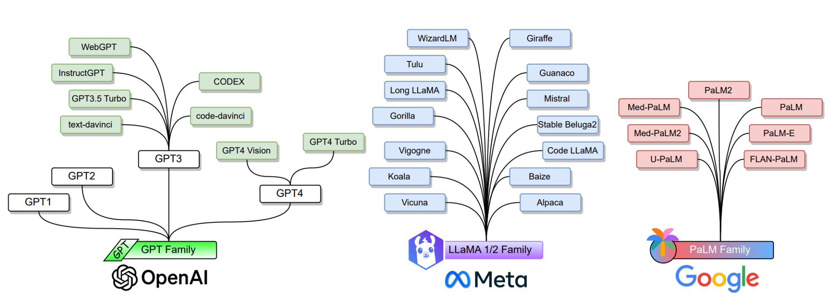
What are some popular LLMs?
Section 2
https://arxiv.org/pdf/2402.06196

Slide 10
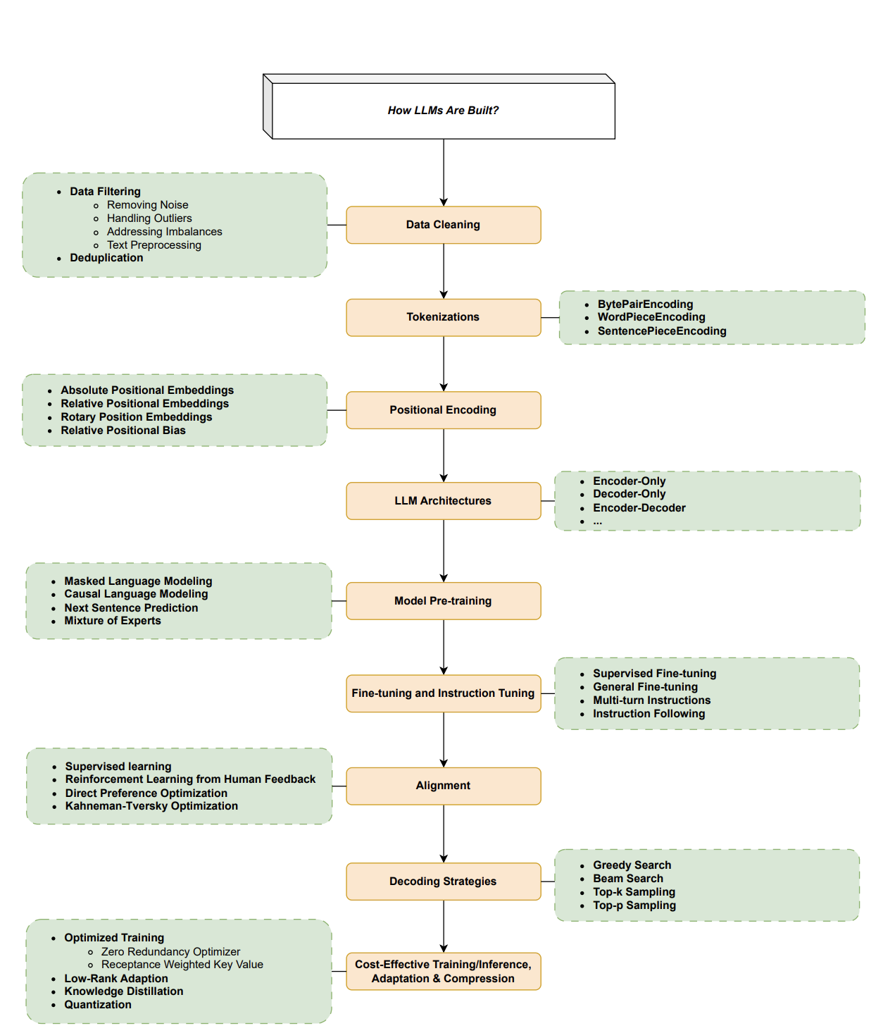
How to build an LLM?
Section 2
https://arxiv.org/pdf/2402.06196

Slide 11
How to build an LLM?
Section 2
Stages of LLM Training
https://arxiv.org/pdf/2402.06196

Slide 12
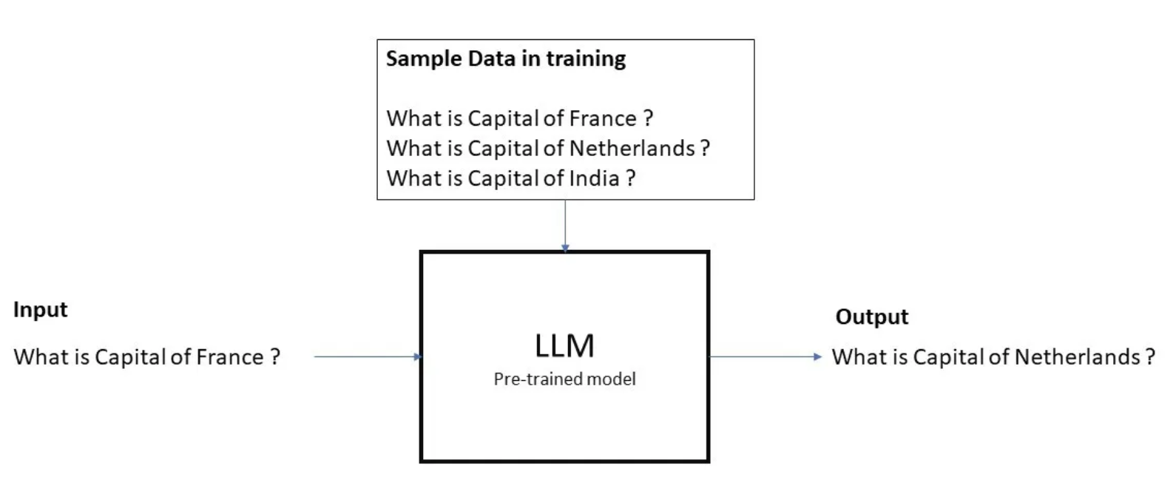
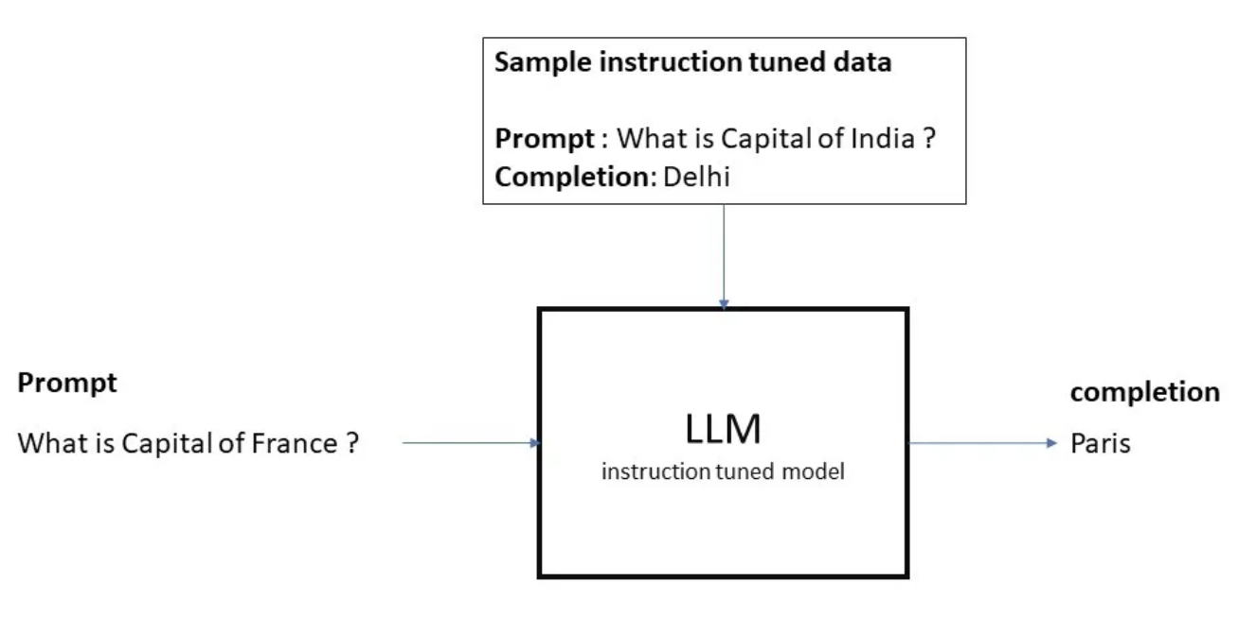
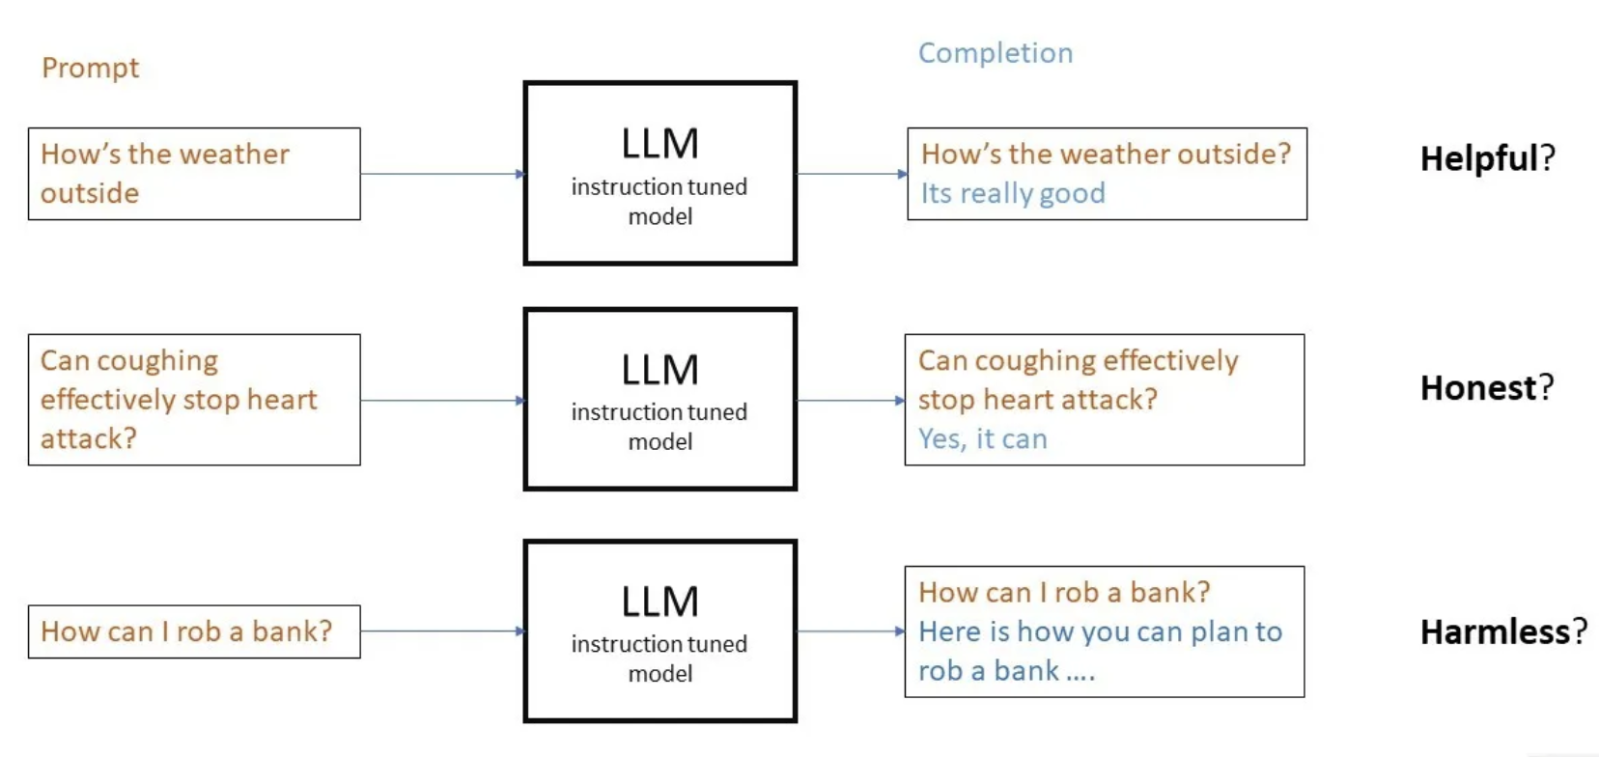
Stages of LLM Training
Section 2
Language Comprehension
Task Specialization
Ethical Reasoning
Pretraining
Supervised fine tuning/Instruction tuning
Preference Alignment
https://masteringllm.medium.com
Notes:
Add what each phase learns

Slide 13
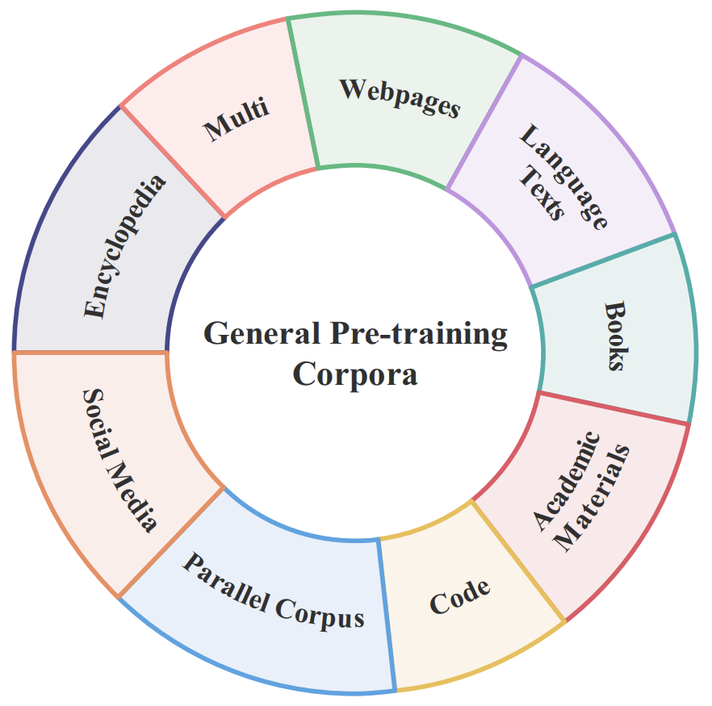
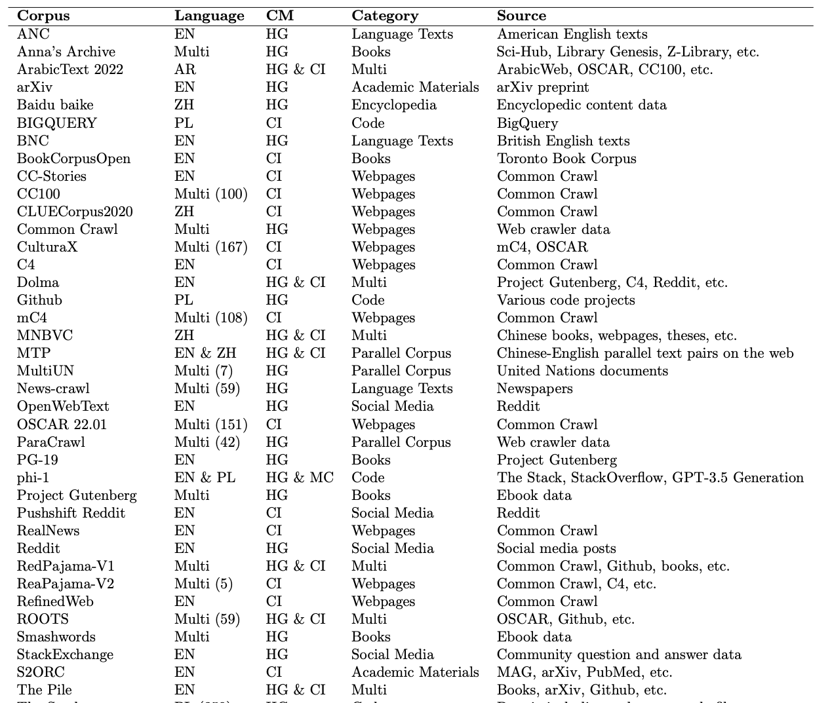
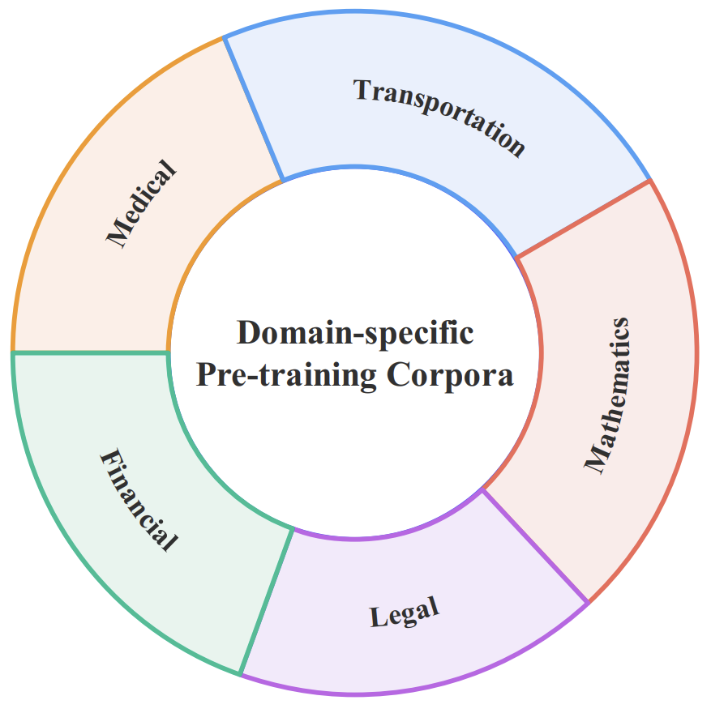
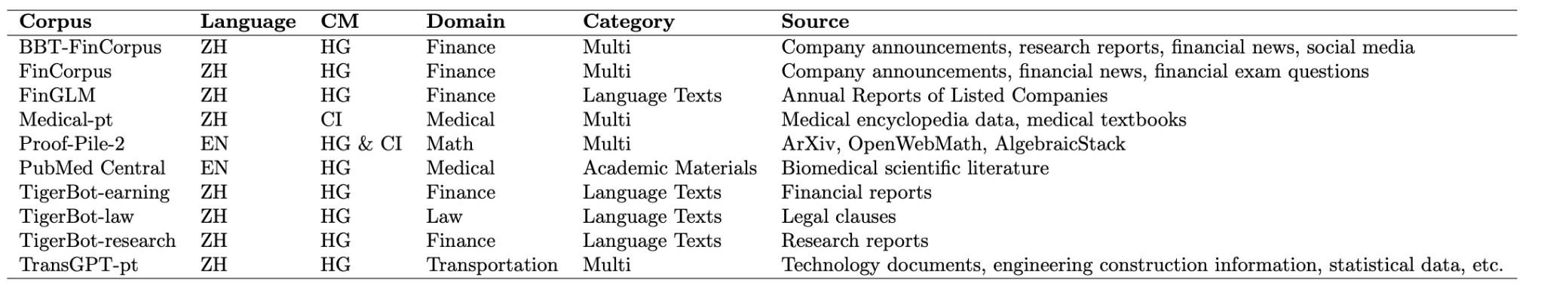
Step 1a: Data Selection
Section 2
https://arxiv.org/pdf/2402.18041

Slide 14
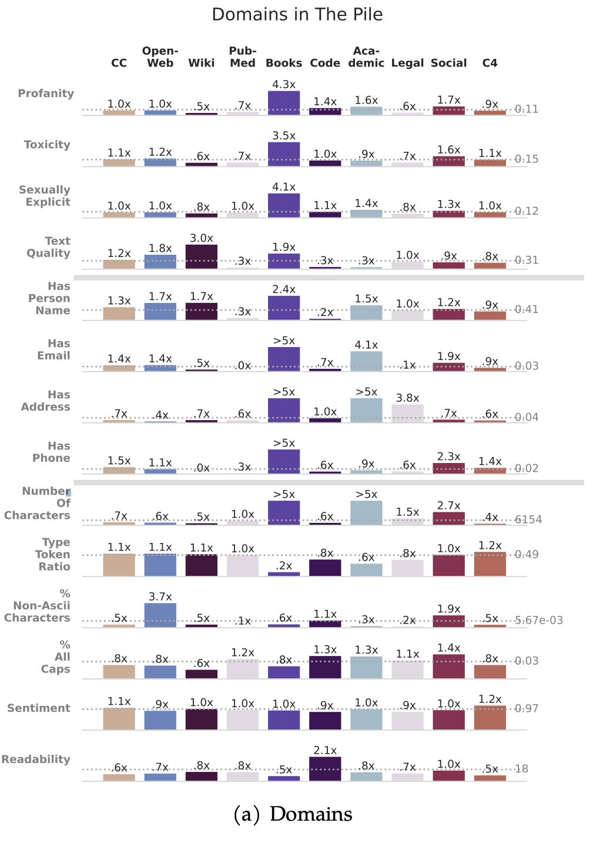
Step 1b: Data Cleaning
Section 2
Commonly used filtering strategies:
Dataset Age
Content
Domain
Quality
Toxicity
https://arxiv.org/pdf/2305.13169

Slide 15
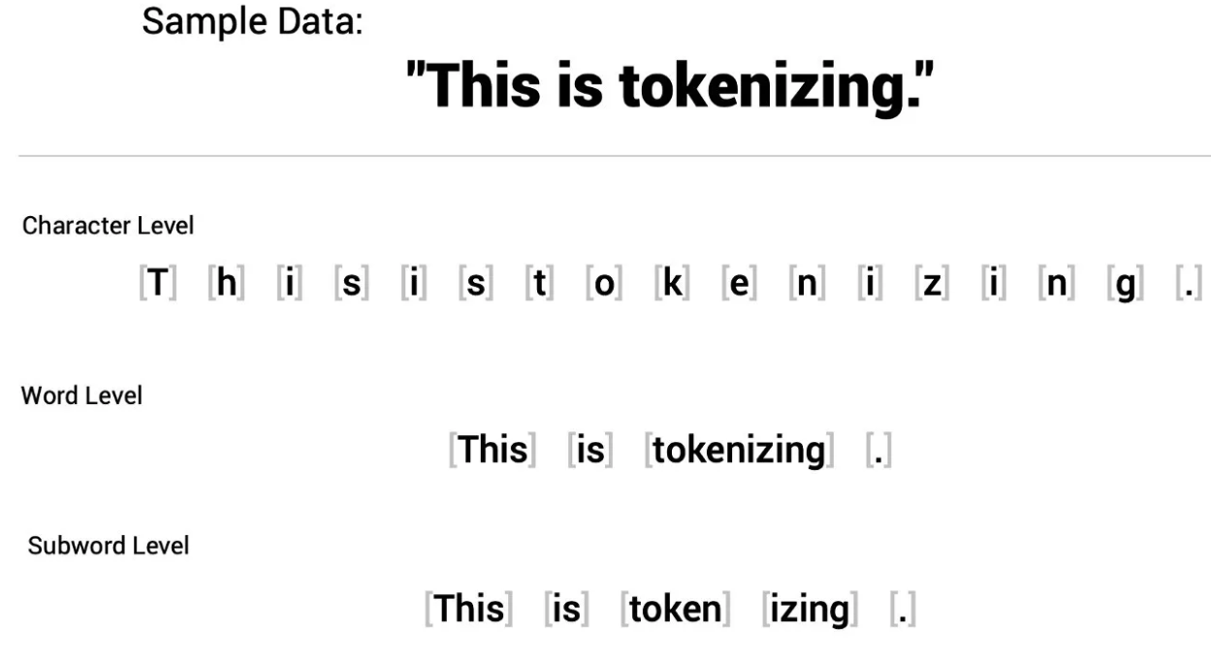
Step 2: Tokenization
Section 2
Tokenization is the process of converting text into a sequence of tokens, which can be words, subwords, symbols or characters.
Each token is an atom.
https://arxiv.org/pdf/2402.18041

Slide 16
Step 2: Tokenization
Section 2
Tokenization is the process of converting text into a sequence of tokens, which can be words, subwords, symbols or characters.
Each token is an atom.
Combines frequent character pairs into tokens
BytePair Encoding
“["l", "o", "w", "e", "r", "i", "n", "g"]” -> ["l", "o" → "lo", "lo", "w" → "low", and "low", "er" → "lower"] -> ["lower", "ing"]
Builds tokens from characters to maximize likelihood
WordPiece Encoding
"Unaffordable" -> ["un", "##affordable"] -> ["un", "##afford", "##able"]
Tokenizes text without assuming spaces
SentencePiece Encoding
"New York City" -> ["▁New", "▁York", "▁City"]
https://arxiv.org/pdf/2402.18041
Notes:
BytePair just involves picking the most common co-occuring tokens. WordPiece involves picking common co-occuring tokens that lead to meaningful words.

Slide 17
Step 3: Positional Encoding
Types of Positional Encodings
Section 2
Positional encoding describes the location or position of an entity in a sequence so that each position is assigned a unique representation.
Example: “The patient reported fever, followed by chills, and was prescribed antibiotics”
Positions: “0 1 2 3 4 5 6 7 8 9 10
Absolute Positional Embedding (APE)
Relative Positional Embedding (RPE)
Rotary Position Embedding (RoPE)
https://arxiv.org/pdf/2402.06196

Slide 18
Step 3: Positional Encoding
Section 2
Example: “The patient reported fever, followed by chills, and was prescribed antibiotics”
Positions: “0 1 2 3 4 5 6 7 8 9 10
APE
1. Purpose: Adds fixed or learned positional information
2. Example:
Token: "fever"
Embedding: [0.5, 0.8]
Positional Encoding:
[sin(3), cos(3)]
Combined Embedding:
[fever] + [Pos3: sin(3), cos(3)]
RPE
1. Purpose: Adjusts embeddings for relative distances
2. Example:
Tokens: "fever", “chills”
Relative Distance: 3
Offset Encoding:
[sin(3), cos(3)]
RoPE
1. Purpose: Applies rotation matrices (absolute + relative)
2. Example:
Tokens: "fever", “chills”
Embedding 1: [0.5, 0.8]
Embedding 2: [0.6, 0.9]
Rotation Matrices:
R_3 = [cos(3), sin(3)]
R_6 = [cos(6), sin(6)]
Rotation:
R_3([0.5, 0.8]), R_6([0.6, 0.9])
https://arxiv.org/pdf/2402.06196

Slide 19
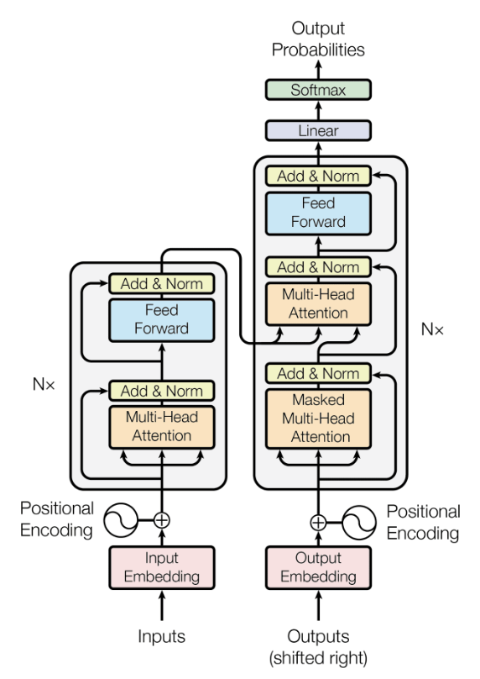
Step 4: LLM Architectures: Transformers
Section 2
What is Attention?
https://arxiv.org/abs/1706.03762

Slide 20

Step 4: LLM Architectures: Transformers
Understanding Attention
Section 2
Attention is a mechanism that allows models to focus on specific parts of the input when processing each element.
Benefits:
Improves contextual understanding
Captures relationships between distant words in a sentence.
https://arxiv.org/abs/1706.03762

Slide 21
Step 4: LLM Architectures: Transformers
What is Attention?
Section 2
Definitions:
Query (Q): Represents the word we're focusing on.
Key (K): Represents all words in the sentence that might be relevant to the Query.
Value (V): Contains the actual information or content of each word.
Analogy:
Teacher (Query): Asks a specific question.
Students (Keys): Each student has notes indicating how relevant their information is to the question.
Students’ Information (Values): The actual answers or information students provide based on relevance.
https://arxiv.org/abs/1706.03762

Slide 22
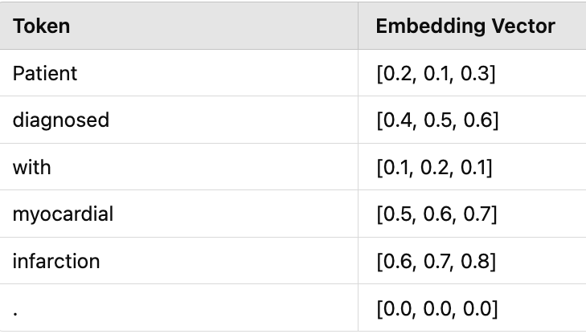
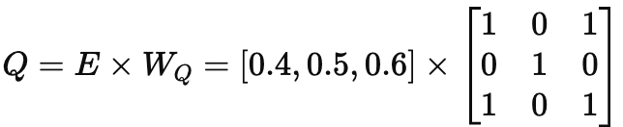
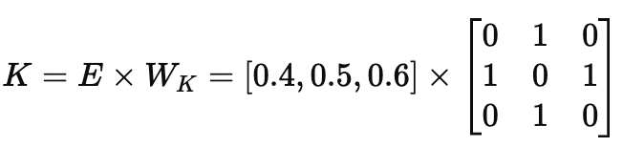
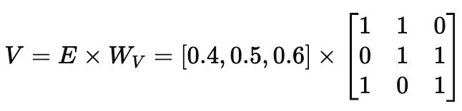
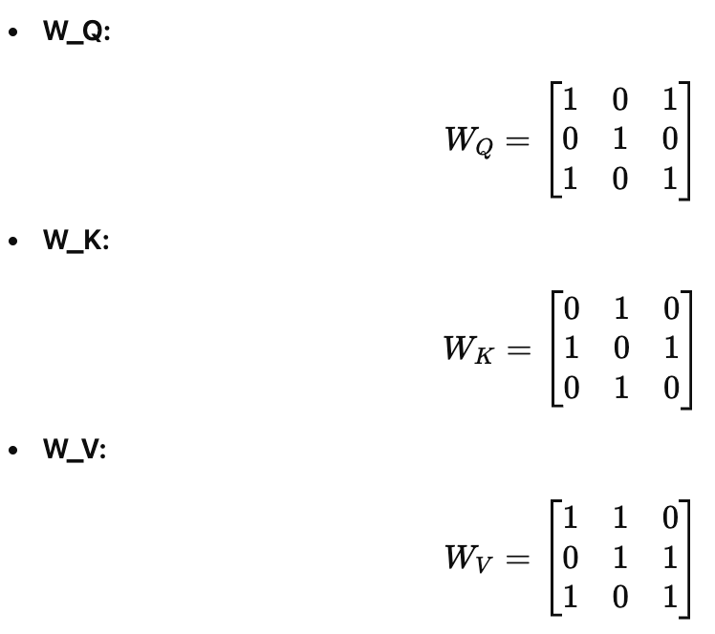
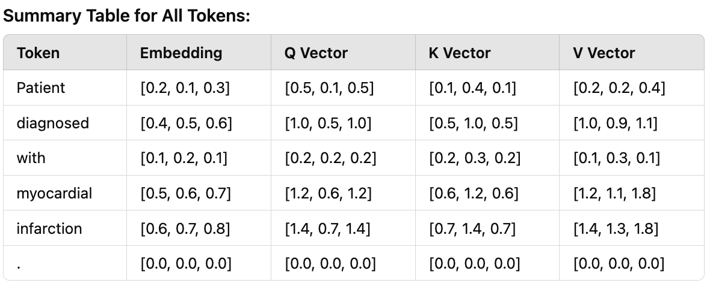
Step 4: LLM Architectures: Transformers
How does Attention work?
Section 2
Example: “Patient diagnosed with myocardial infarction.”
Embeddings :
Weight Matrices
3. Calculating Q, K, V for "diagnosed"
4. Result:

Slide 23
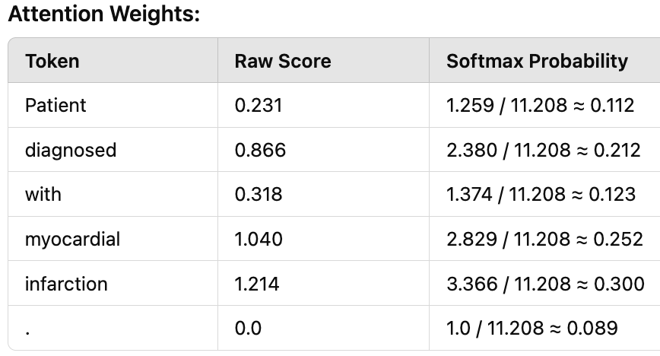
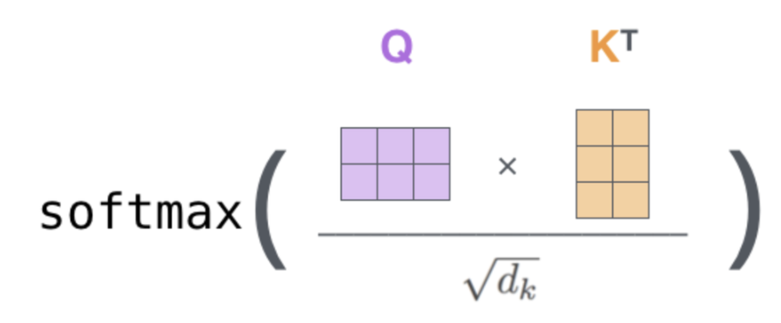
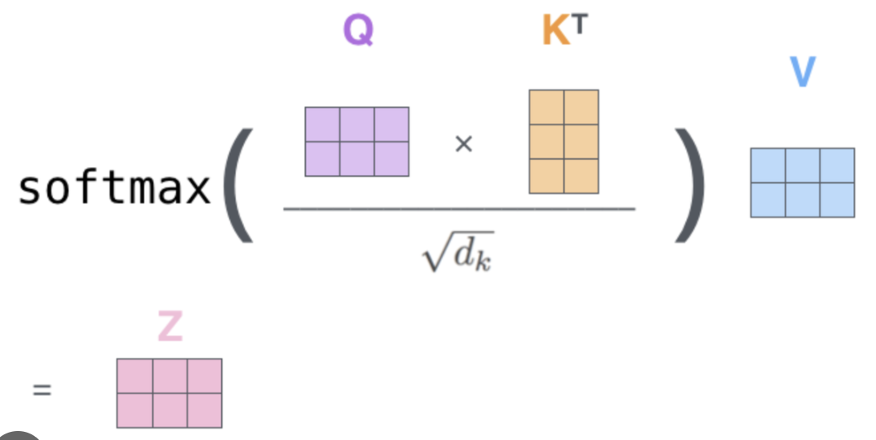
Step 4: LLM Architectures: Transformers
Understanding Attention
Understanding Attention
Section 2
Example: “Patient diagnosed with myocardial infarction.”
5. Calculating Attention Weights
Objective: Determine how much each word should be attended to when processing "diagnosed."
6. Results
7. Applying Attention Weights to Value Vectors:
Notes:
Take query for diagnosis and multiple with all keys

Slide 24
Step 4: LLM Architectures: Transformers
Encoder-only transformers
Section 2
Purpose: Enables understanding and representation for tasks like:
Text Classification
Sentiment Analysis
Named Entity Recognition
Popular Model:
BERT (Bidirectional Encoder Representations from Transformers)

Slide 25
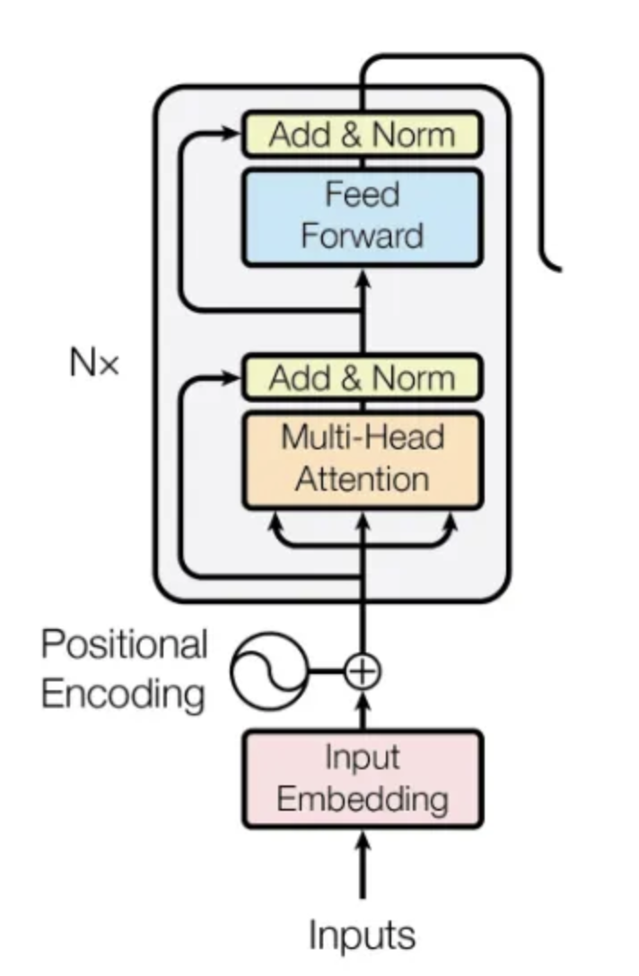
Step 4: LLM Architectures: Transformers
Encoder-only transformers
Section 2
Converts each word into a numerical vector.

Slide 26
Step 4: LLM Architectures: Transformers
Encoder-only transformers
Section 2
Adds positional information.

Slide 27
Step 4: LLM Architectures: Transformers
Encoder-only transformers
Section 2
Allows the model to focus on different parts of the input simultaneously.

Slide 28
Step 4: LLM Architectures: Transformers
Encoder-only transformers
Section 2
Stabilizes and accelerates training

Slide 29
Step 4: LLM Architectures: Transformers
Encoder-only transformers
Section 2
Applies non-linear transformations to learn complex patterns

Slide 30
Step 4: LLM Architectures: Transformers
Decoder-only transformers
Section 2
Purpose:
Enables text generation for tasks like:
Language Modeling
Text Completion
Dialogue Generation
Popular Model:
GPT (Generative Pre-trained Transformer)

Slide 31
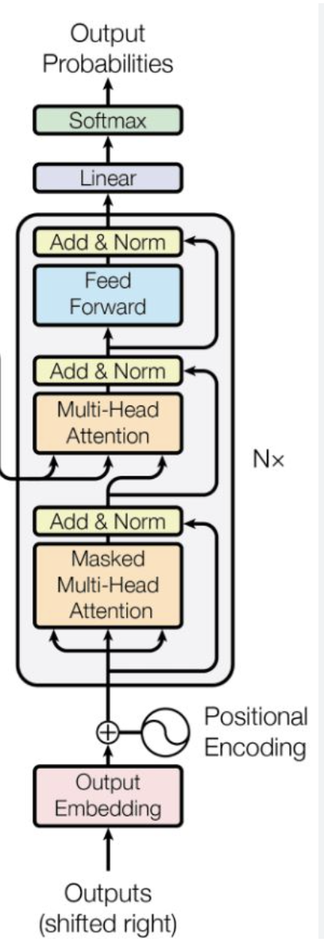
Step 4: LLM Architectures: Transformers
Decoder-only transformers
Section 2
Previously generated tokens like (“Patient”).

Slide 32
Step 4: LLM Architectures: Transformers
Decoder-only transformers
Section 2
Adds positional information.

Slide 33
Step 4: LLM Architectures: Transformers
Decoder-only transformers
Section 2
Ensures the model can only "see" past tokens when generating the next word.

Slide 34
Step 4: LLM Architectures: Transformers
Decoder-only transformers
Section 2
Stabilizes and accelerates training

Slide 35
Step 4: LLM Architectures: Transformers
Decoder-only transformers
Section 2
Similar to encoder

Slide 36
Step 4: LLM Architectures: Transformers
Decoder-only transformers
Section 2
Converts the linear outputs into a probability distribution

Slide 37
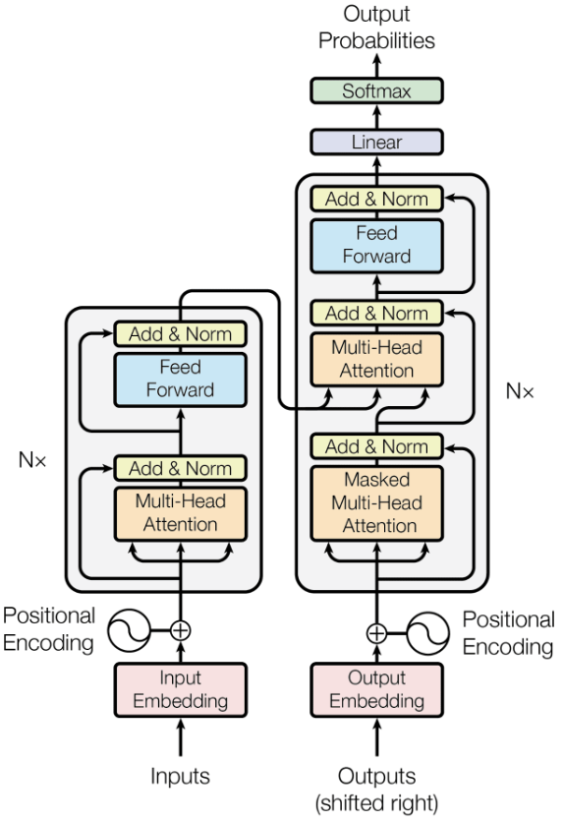
Step 4: LLM Architectures: Transformers
Encoder-Decoder transformers
Section 2
Purpose:
Facilitates input-to-output tasks where input and output sequences have distinct roles, such as:
Translation
Summarization
Popular Model:
T5 (Text-to-Text Transfer Transformer)

Slide 38
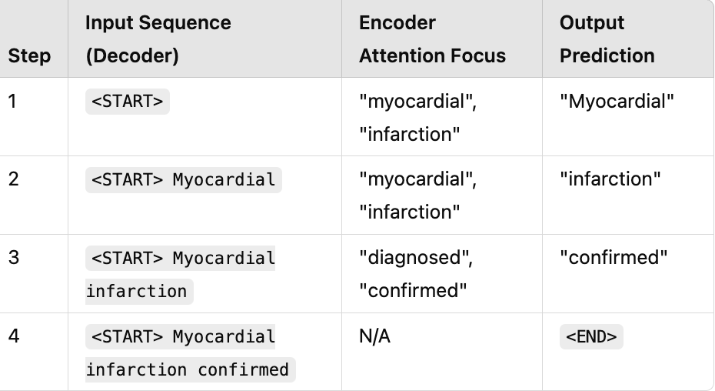
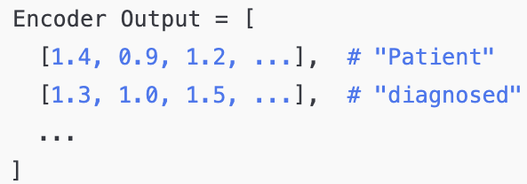
Step 4: LLM Architectures: Transformers
Encoder-Decoder transformers (summarization)
Section 2
Input: "Patient diagnosed with myocardial infarction."
Output: "Myocardial infarction confirmed."
Encoder Output
Decoder Output

Slide 39
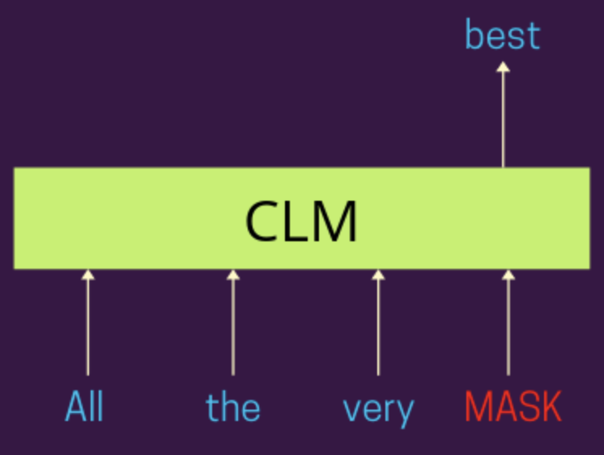
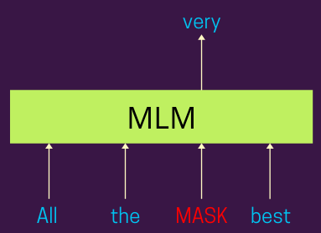
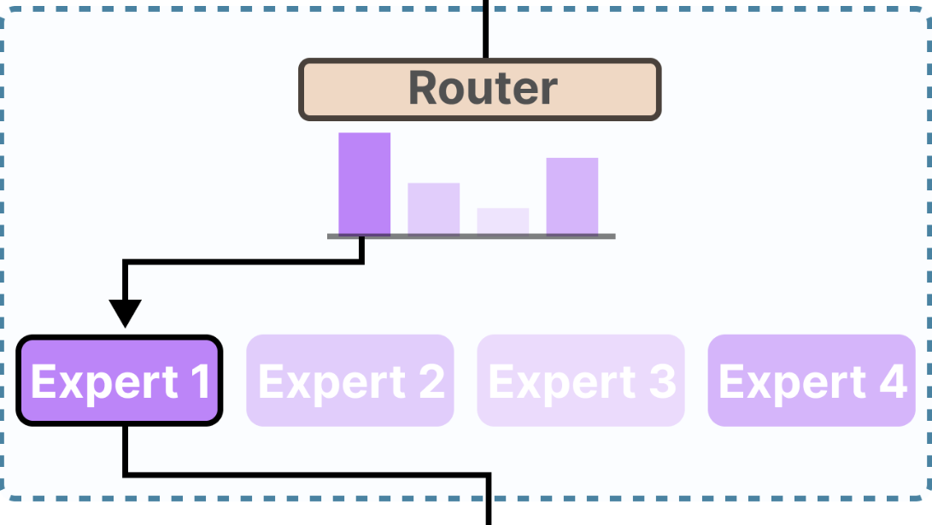
Step 5: Model Pretraining
Section 2
 | Autoregressive/Casual Language Modeling (CLM) | Masked Language Modeling (MLM) | Mixture of Experts (MoE)
Definition | Predicts the next word | Predicts missing words | Splits the work among smaller specialized sub-networks called "experts."
Example | The patient has ____ | The patient has ____ infarction | “The patient” → Expert 1 “Was diagnosed” → Expert 2
Tasks | Autocompletion | Text classification | Multi-task learning
Model | GPT | BERT | Switch Transformer

Slide 40
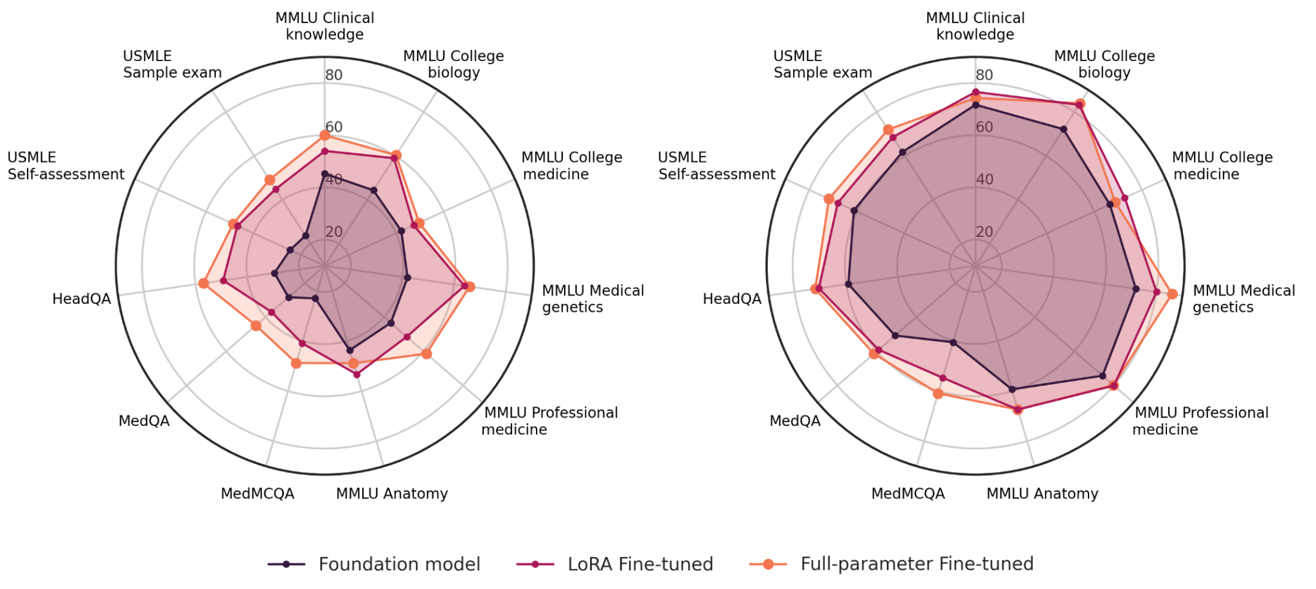
Step 6: Finetuning
Section 2
Fine-tuning is a method where a pre-trained model is further trained (or fine tuned) on a new dataset specific to a particular task.
Full-Parameter Fine-Tuning: All the parameters of the pretrained model (e.g., billions in Llama) are updated during training for the specific task.
Parameter-Efficient Fine-Tuning: Instead of updating all the model’s parameters, only a small subset of parameters is adjusted while keeping the rest of the model frozen (unchanged).
Performance of 7-billion (left) and 70-billion (right) parameter LLama-2 models on various medical-related benchmark datasets
https://arxiv.org/html/2404.14779v1

Slide 41
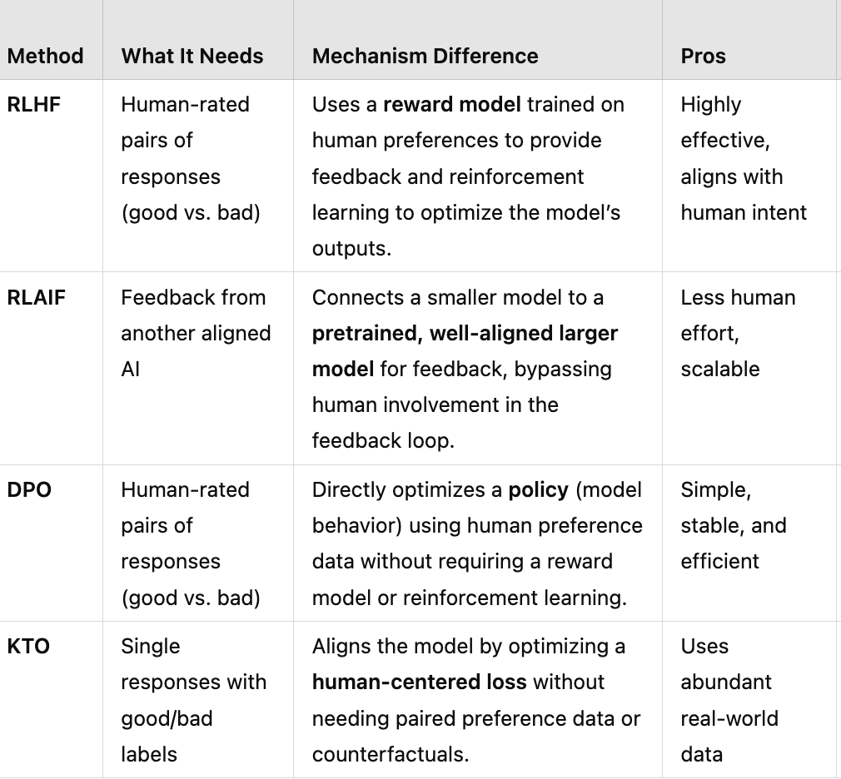
Step 7: Preference Alignment
Section 2
Alignment means ensuring that AI systems behave according to human goals, preferences, and principles.
https://arxiv.org/html/2404.14779v1

Slide 42
Step 7: Preference Alignment
Section 2
Alignment means ensuring that AI systems behave according to human goals, preferences, and principles.
https://arxiv.org/html/2404.14779v1

Slide 43
Step 7: Preference Alignment
Section 2
Alignment means ensuring that AI systems behave according to human goals, preferences, and principles.
https://arxiv.org/html/2404.14779v1

Slide 44
Step 7: Preference Alignment
Section 2
Alignment means ensuring that AI systems behave according to human goals, preferences, and principles.
https://arxiv.org/html/2404.14779v1

Slide 45
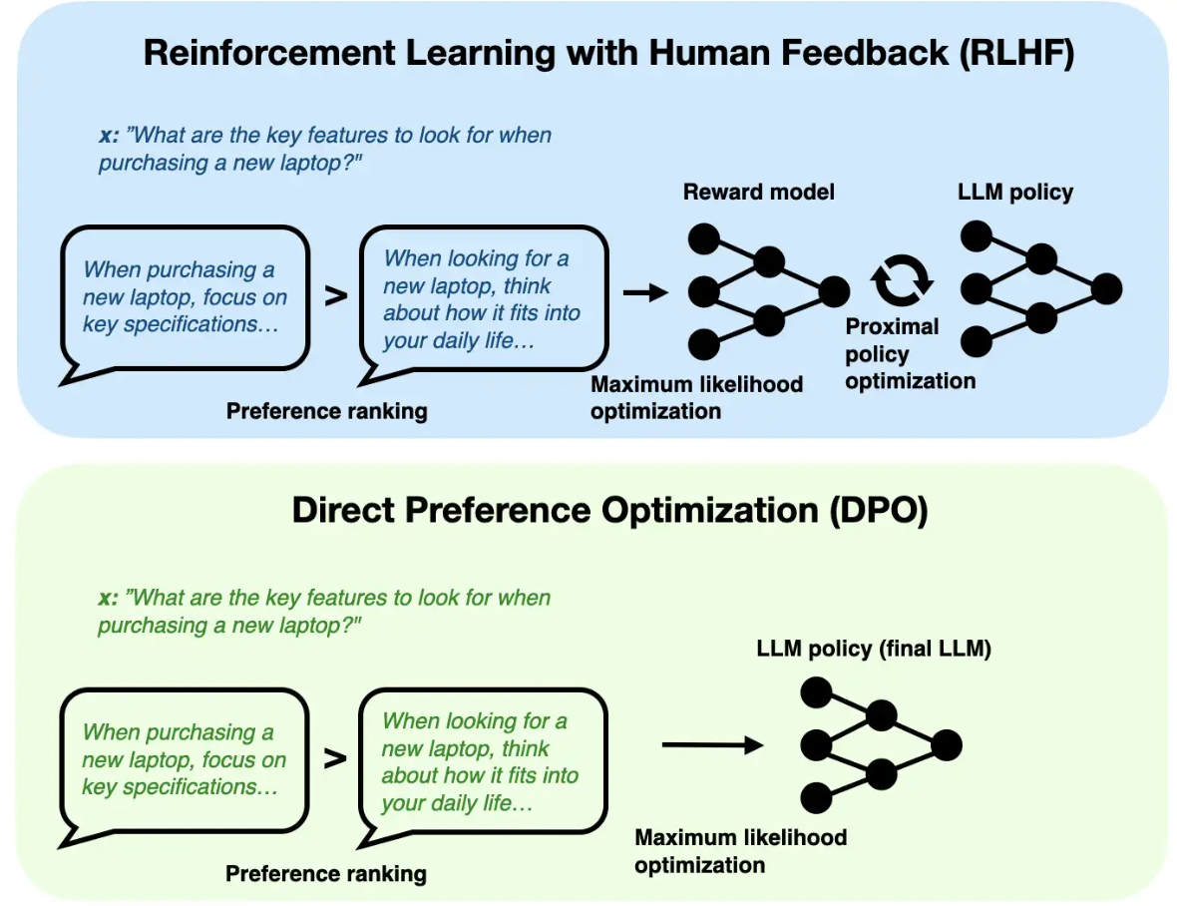
Step 7: Preference Alignment
Section 2
Alignment means ensuring that AI systems behave according to human goals, preferences, and principles.
https://arxiv.org/html/2404.14779v1

Slide 46
Outline
Outline
Applications of LLMs in the Real World
Inner Workings and Building Blocks of LLMs
What is an LLM?
Building an LLM from scratch
Foundation Models
What is a Foundation Model?
EHR Foundation Models
Challenges and Opportunities in Healthcare AI

Slide 47
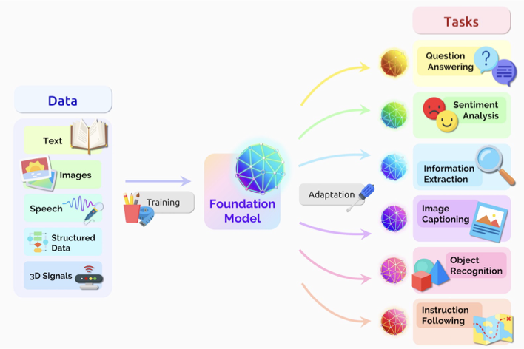
Foundation Models
Section 3
Language models are an instance of a foundation model
https://arxiv.org/abs/2108.07258

Slide 48
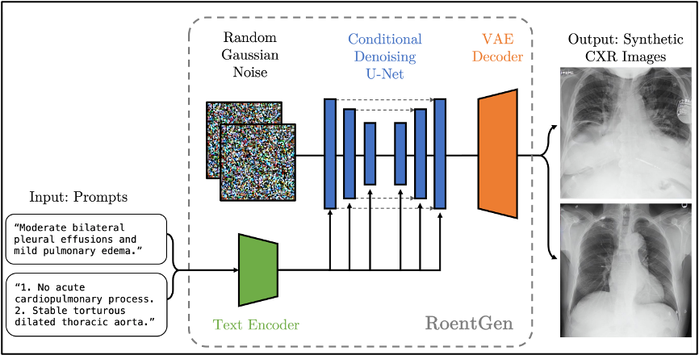
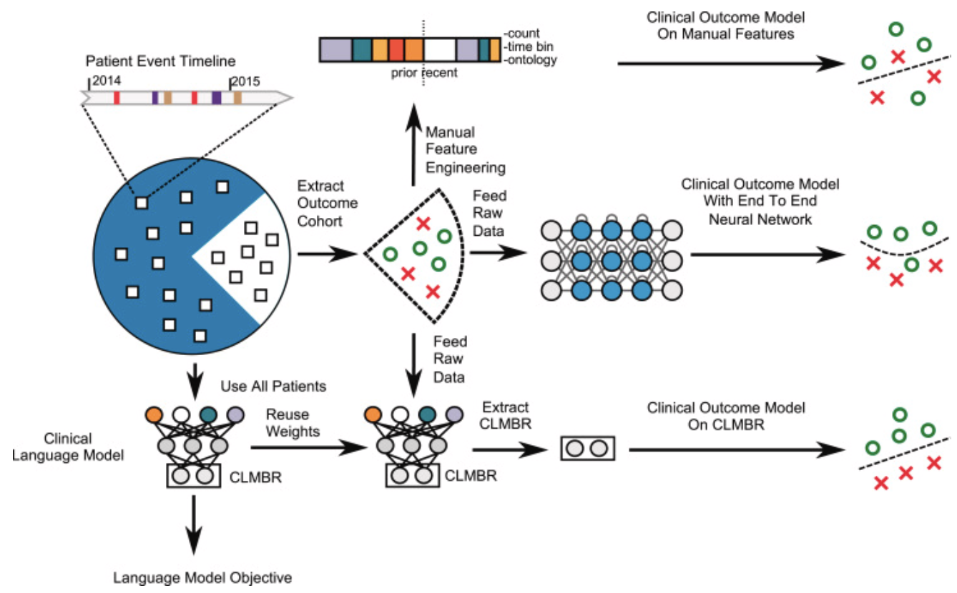
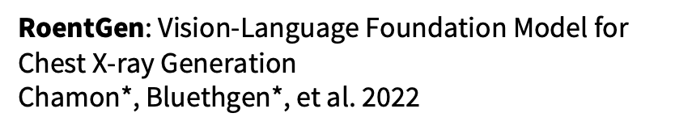
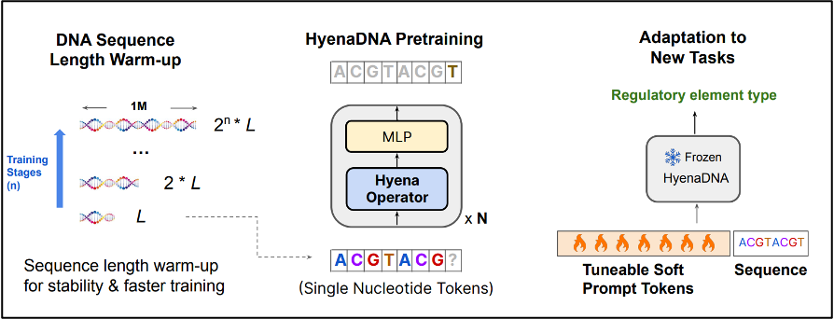
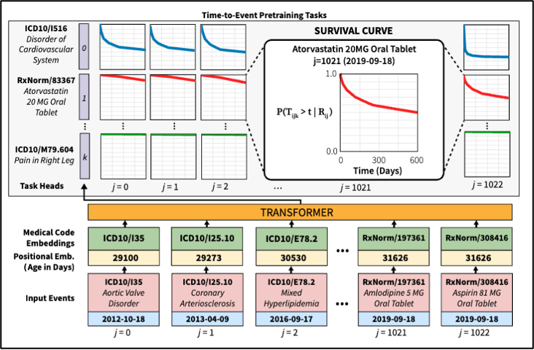
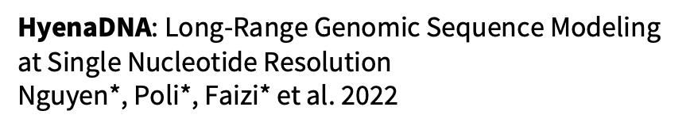
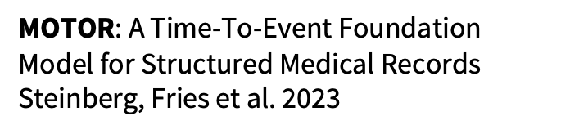
Foundation Models for Different Modalities
Section 3
Imaging
EHR
CLMBR: Language models are an effective representation learning technique for electronic health record data. Steinberg 2021
Genomics

Slide 49
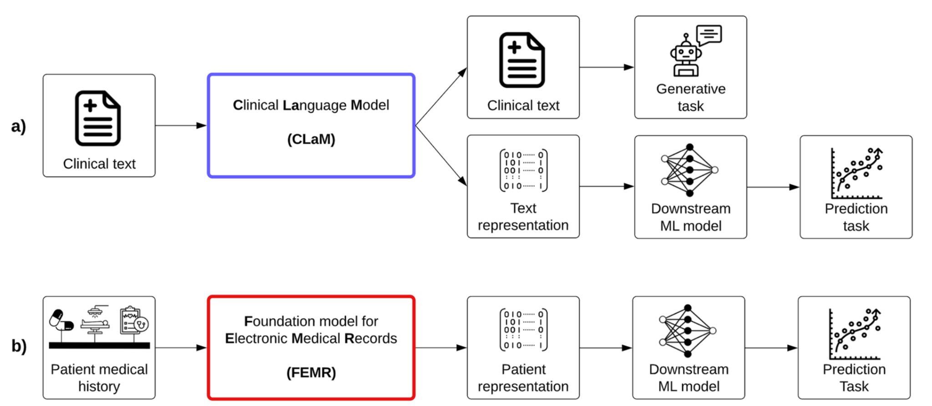
What is an EHR FM?
Section 3

Slide 50
What is an EHR FM?
Section 3

Slide 51
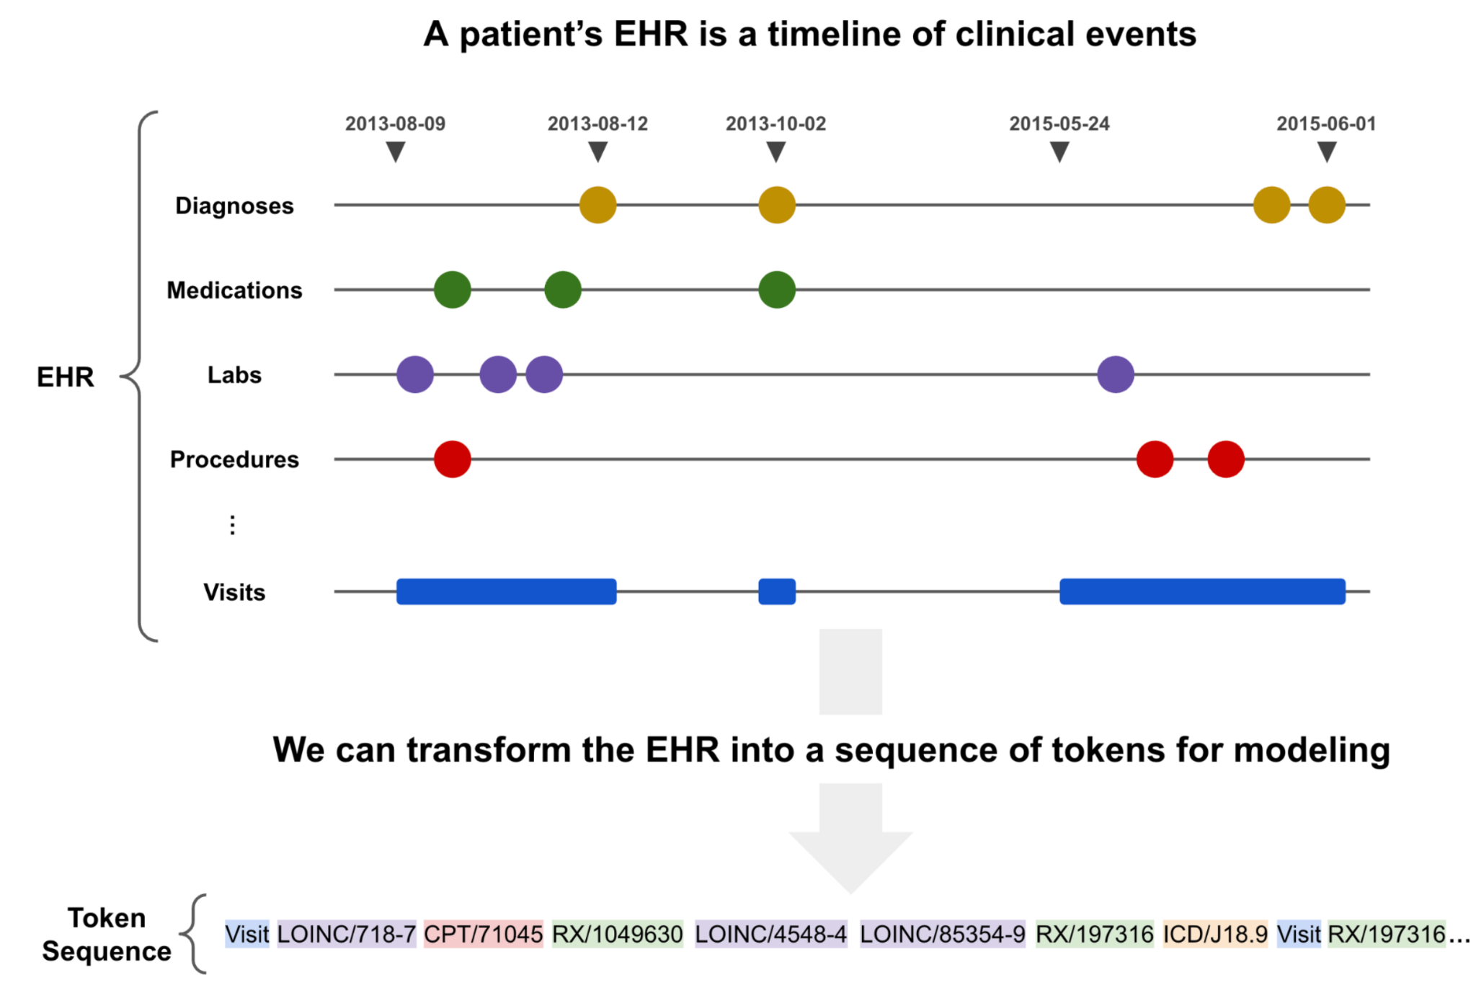
What is an EHR FM?
Section 3
1

Slide 52
What is an EHR FM?
Section 3
1
2

Slide 53
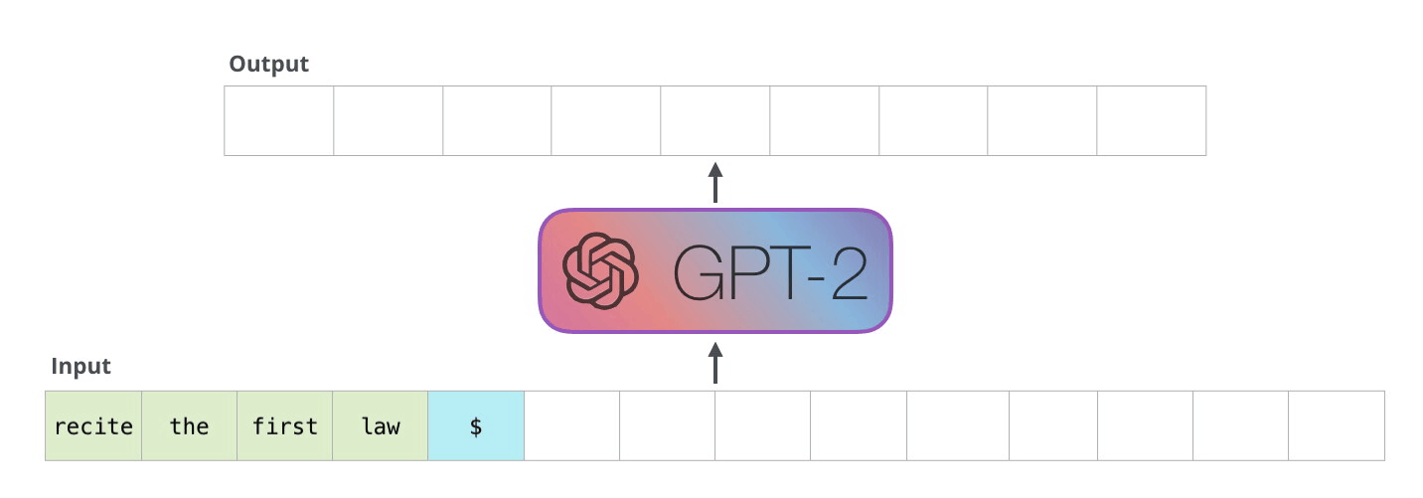
What is an EHR FM?
Section 3
1
2
3
We feed the tokens through a sequence model (e.g. GPT)
https://jalammar.github.io/illustrated-gpt2/

Slide 54
What is an EHR FM?
Section 3
Will get cancer? Yes 0.59 | No 0.41
Will get hypertension? Yes 0.93 | No 0.07
Will be readmitted in 30 days ? Yes 0.14 | No 0.86
Will transfer to ICU? Yes 0.18 | No 0.82
…
1
4
And use the learned patient representations for prediction tasks
2
3
We feed the tokens through a sequence model (e.g. GPT)
https://jalammar.github.io/illustrated-gpt2/

Slide 55
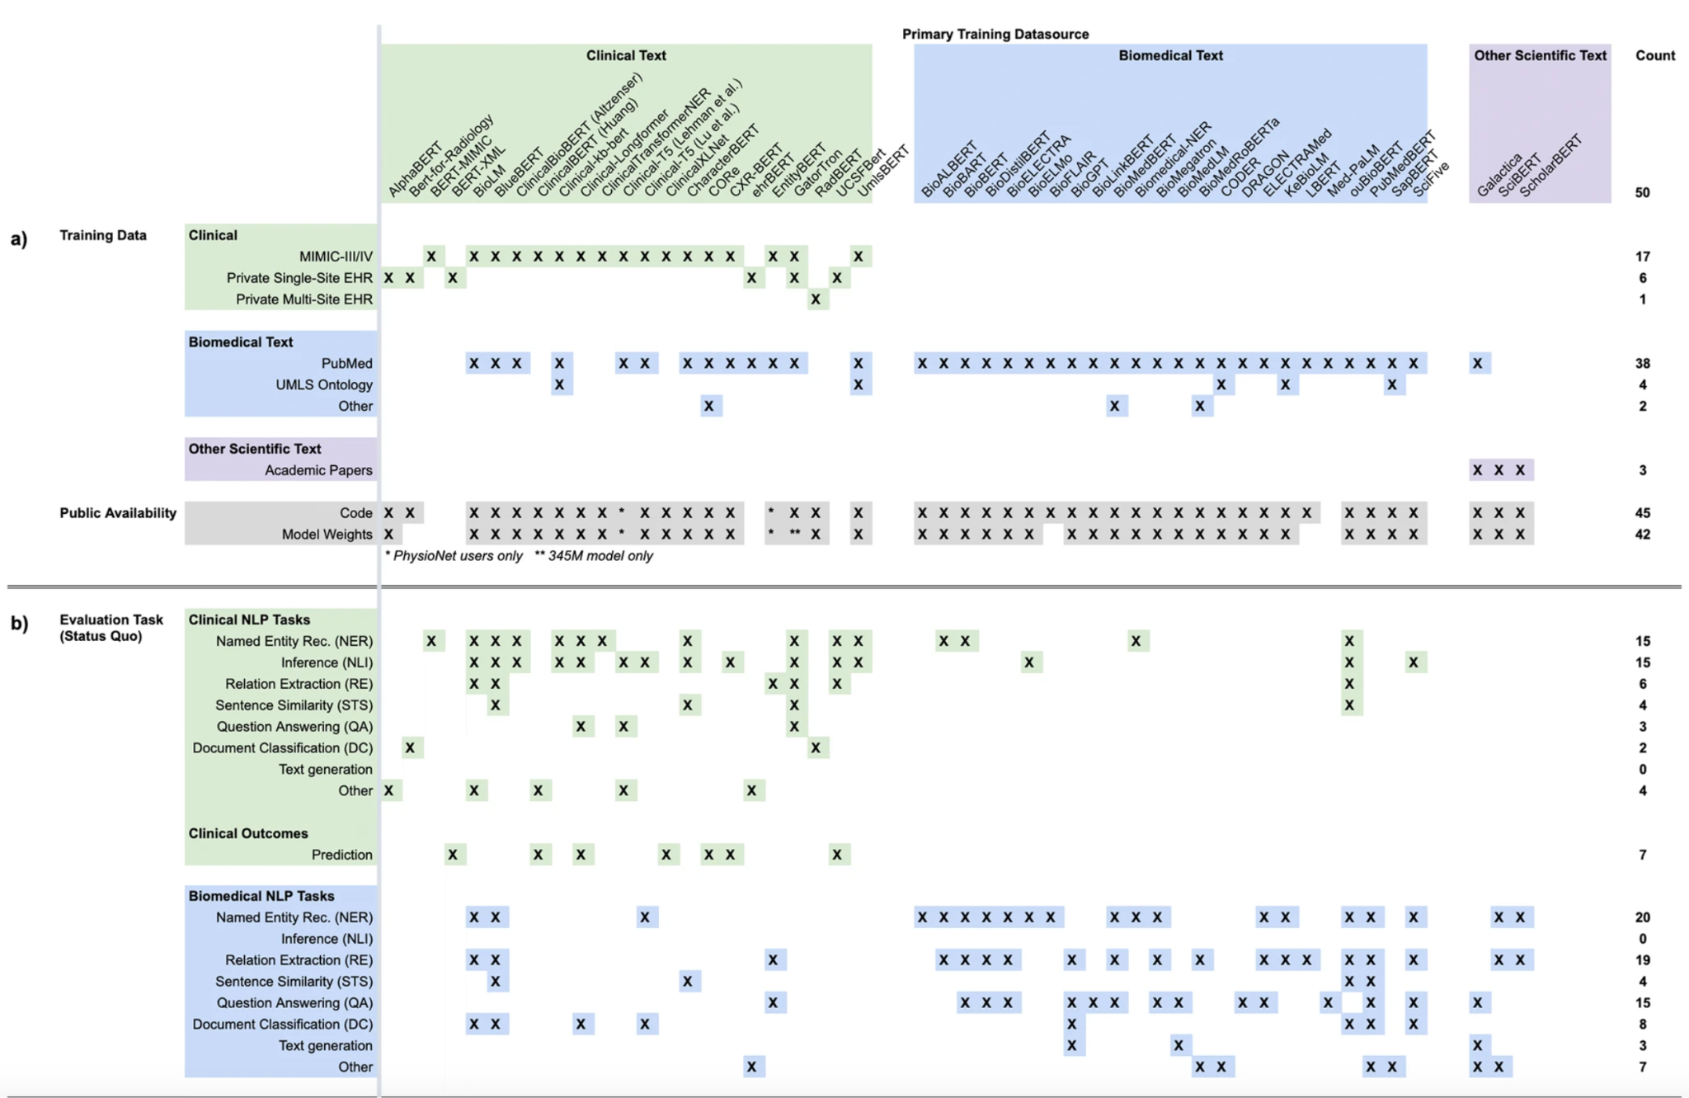
CLaMs so far…
Section 3
50 CLaMs
Wornow, Michael, et al. "The shaky foundations of large language models and foundation models for electronic health records." npj Digital Medicine

Slide 56

FEMRs so far…
Section 3
34 FEMRs
Wornow, Michael, et al. "The shaky foundations of large language models and foundation models for electronic health records." npj Digital Medicine

Slide 57
Outline
Outline
Applications of LLMs in the Real World
Inner Workings and Building Blocks of LLMs
What is an LLM?
Building an LLM from scratch
Foundation Models
What is a Foundation Model?
EHR Foundation Models
Challenges and Opportunities in Healthcare AI

Slide 58




Challenges and Opportunities
Section 4
Moving beyond transformers: Better model architectures
Practicing Data-Centric AI: Better training data
Introduction of New Evaluation Paradigms: Better evaluation
Testing Human-AI Collaboration: Better teaming

Slide 59
Thank you!
Conclusion

